Slide 1

HAMBURG RACE PREVIEW
Race Analysis · July 9 – 12, 2026
USA Triathlon High Performance

Slide 2
Race Week Schedule
Hamburg
July 9 – 12, 2026 • Rathausmarkt / Binnenalster, Hamburg, Germany (CEST, UTC+2)
Fri • July 10
Sat • July 11
Sun • July 12
Familiarization & Briefing
ELITE SPRINT RACE DAY
Mixed Relay Day
TBD | Course familiarization — swim, bike, run circuits
TBD | ★ Mandatory Elite athlete briefing
TBD | Race package distribution
11:30 – 12:45 | Elite Men — athletes' lounge check-in + warm-up
12:15 – 13:00 | Elite Men — swim warm-up + transition check
13:10 | Elite Men — athletes' introduction
13:15 | ★ ELITE MEN START
~14:06 | Elite Men — projected finish
14:15 | Elite Men medals ceremony
13:45 – 14:45 | Elite Women — athletes' lounge check-in + warm-up
14:15 – 14:55 | Elite Women — swim warm-up + transition check
14:50 | Elite Women — athletes' introduction
15:00 | ★ ELITE WOMEN START
~15:55 | Elite Women — projected finish
16:05 | Elite Women medals ceremony
Evening | Mixed Relay team declaration
TBD | Mixed Relay team managers' meeting
17:30 | ★ MIXED RELAY START
~18:45 | Mixed Relay projected finish
Post-finish | Mixed Relay medals ceremony
Times Rathausmarkt / Binnenalster, Hamburg, Germany (CEST, UTC+2). Schedule confirmed from World Triathlon race-info page / athlete guide; subject to organiser updates.

Slide 3
Key Course Differentiators
Hamburg
HAMBURG
COURSE AT A GLANCE
WTCS Hamburg is one of the sport's flagship city-center races, set in the heart of Hamburg along the Binnenalster and the historic Rathausmarkt. The sprint format rewards athletes who can handle high-frequency cornering on the bike and can run at the pointy end of the field. Hamburg has hosted elite triathlon since 2008 and consistently delivers fast, tactical racing in front of one of the largest crowds on the WTCS calendar.
Swim:
750 m – 1 lap
Bike:
19.8 km – 6 laps × 3.3 km
Run:
10 km – 2 laps × 5 km
Format:
Sprint Triathlon
Bike Laps:
6
COURSE FEATURES
Run Laps:
2
• Sheltered 750 m Binnenalster swim. Typically flat fresh water. Pontoon start and likely a non-wetsuit swim.
QUICK LINKS
Current Race Info:
• 6 × 3.3 km urban bike (19.8 km). Flat but highly technical course with multiple turns. Large packs historically come together.
Race Info | 2026 World Triathlon Championship Series Hamburg
• 2 × 5 km flat run through city-center streets. Despite some cobblestone sections this is typically a fast run that comes down to a late surge.
• Elite Men 13:15 / Elite Women 15:00 Saturday July 11. Mixed Relay Sunday July 12.

Slide 4
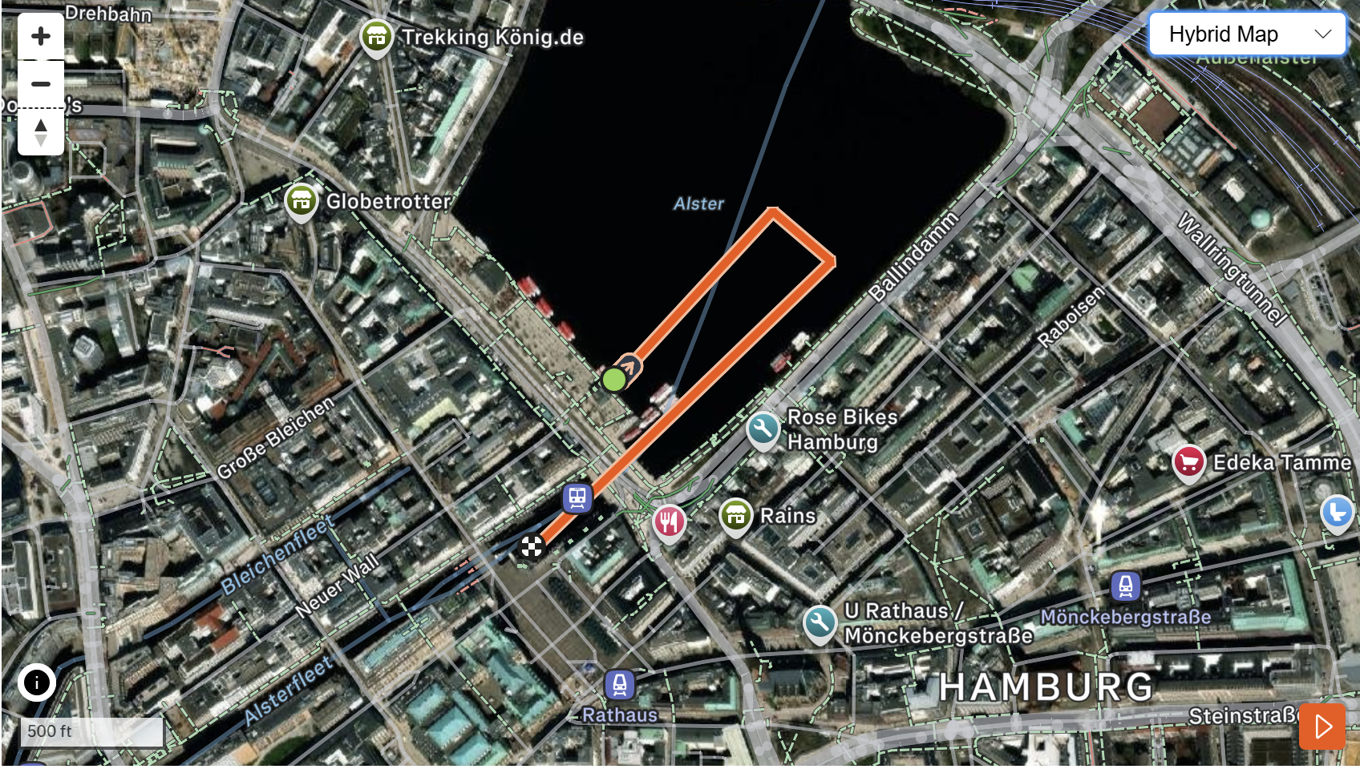
Swim Course Profile
Hamburg
750 m • single lap
Sheltered urban lake — fresh water, calm conditions
Distance
Body of Water
Start
750 m
River
Pontoon start
[Drop swim course map here] Save the organiser map as: ppt files/support/hamburg_swim_course.png It will be embedded automatically on the next run.
Water Temp
Wetsuit
Lap Count
18.0–22.0 °C
Likely non-wetsuit
1
Tactical Notes
• Single 750 m loop with a pontoon start into the Alster canal.
• Fresh water lake in city center. Typically fairly calm conditions
• July morning water mid-to-high teens Celsius. Potential for wetsuit, but has historically been above the limit.
Source: World Triathlon race info — 2026 WTCS Hamburg
• Short run into T1 from the Alster exit ramp; transition area directly adjacent to city hall

Slide 5
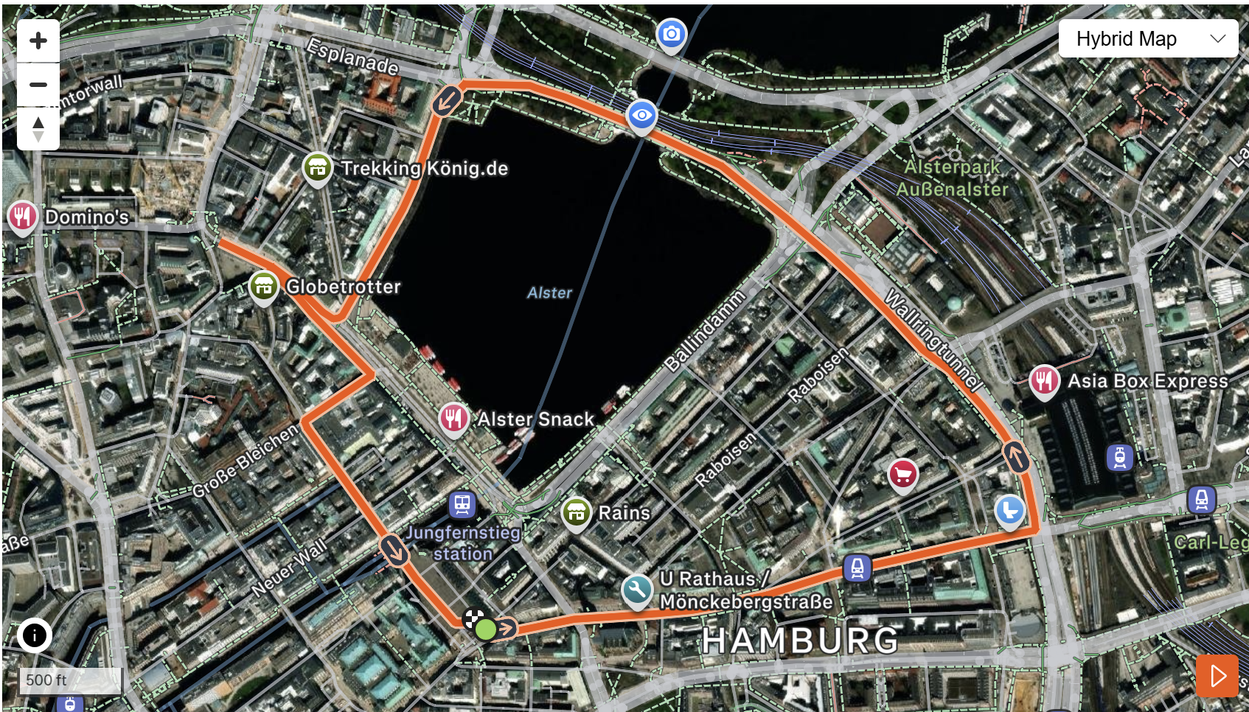
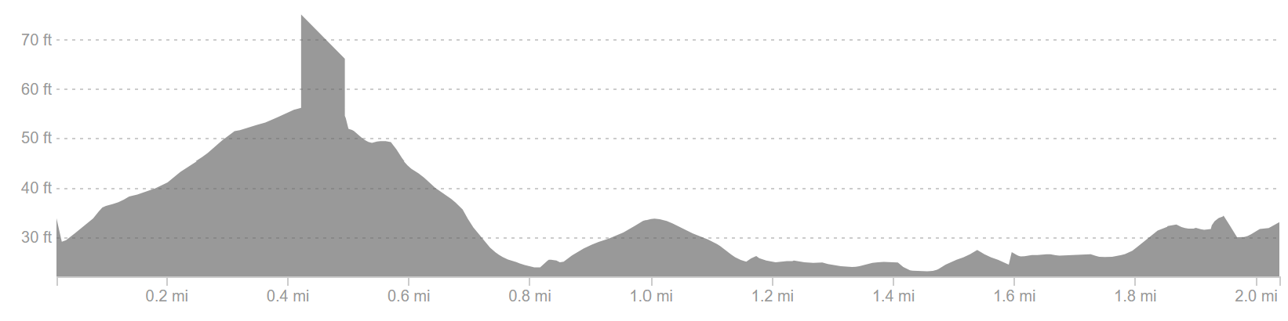
Bike Course Profile
Hamburg
19.8 km • 6 × 3.3 km loops
Closed urban circuit — Rathausmarkt, Alsterufer, Jungfernstieg
[Drop course map here] Save the organiser course map as: ppt files/support/hamburg_bike_course.png It will be embedded automatically on the next run.
Elevation / Lap
Total Climb
Avg Grade
27 ft / lap
162 ft
~0-1%
Max Climb Grade
Wind
Loops
7%
City-center setting
6 × 3.3 km
Tactical Implications
• Hamburg's city center bike represents one of the most technical WTCS bike courses. Pancake-flat throughout, but high-frequency turns reward bike-handling skills alongside power.
Source: World Triathlon race info — 2026 WTCS Hamburg
• Drafting packs form easily on the long straights; Hamburg historically produces large lead packs of 30+ athletes. Cobblestone sections add additional complexity
Flat course — published profile shows no significant climbs. No elevation chart synthesized; if a race GPS FIT becomes available, real contours will replace this block.

Slide 6
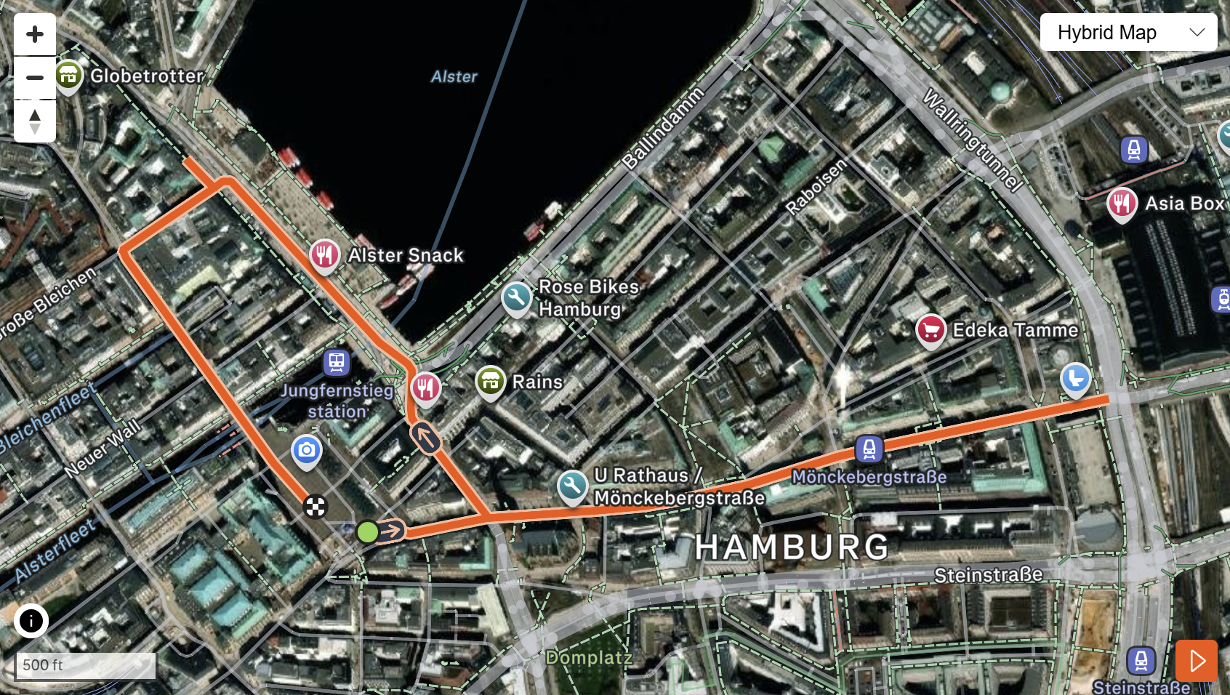
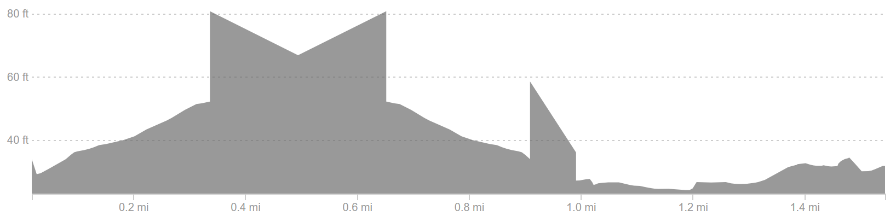
Run Course Profile
Hamburg
5.0 km • 2 × 2.5 km
Closed urban — Rathausmarkt, Alsterarkaden, city hall precinct
Distance
Lap Structure
Total Climb
5.0 km
2 × 2.5 km
136 ft
[Drop run course map here] Save the organiser map as: ppt files/support/hamburg_run_course.png It will be embedded automatically on the next run.
Avg Grade
Max ▲ / ▼
Heat Risk
~0-1%
+ 1.8%
LOW–MODERATE
Tactical Notes
• 2 × 2.5 km laps through Hamburg's historic city center offers a flat, fast, and most importantly a spectator-dense course
• Cobblestone sections add additional terrain from typically road surfaces.
• July Hamburg averages ~22 °C, manageable but warm
Source: World Triathlon race info — 2026 WTCS Hamburg

Slide 7
Travel & Arrival Load
Denver, CO → Hamburg race week
Core travel read
Denver → Hamburg requires one or two stops. Typical routes connect through London (LHR), Amsterdam (AMS), Frankfurt (FRA), or Paris (CDG) before the short connection into Hamburg (HAM). Lufthansa and United operate the best options from DEN. CEST (UTC+2) is 8 hours ahead of MDT. Hamburg Airport (HAM) is 10 km from the city center. Taxi/rideshare ~20 min, S-Bahn line S1 links the airport to the Hauptbahnhof in ~25 min. Most WTCS hotels sit within 1–2 km of the Alster.
Primary route
Flight time
Time zones
Airport Transfer
Transfer Distance
DEN → HAM
~14–16h
+8h
HAM → City Center
~10 km
1–2 stops
Including layover
CEST ahead of MDT
S-Bahn S1 ~25 min or taxi ~20 min
HAM Airport to Binnenalster
Host Hotel / Official Accommodation
Food / Grocery Options Near Hotel + Venue
• Historic WTCS host hotels cluster along the Außenalster and inner city: Radisson Blu, Fairmont Hotel Vier Jahreszeiten, and NH Hotels are common LOC choices.
• Best stock-up: REWE, Edeka, or Aldi branches within 10 min walk of the Binnenalster area; Hamburger Str / Mönckebergstraße corridor has most options.
• Binnenalster / Rathausmarkt area gives walking distance to transition. No shuttle needed for pre-race check-in or familiarization.
• Quick basics: dm (pharmacy), Starbucks, Backwerk, and bakeries throughout the Rathausmarkt pedestrian zone.
• City centre parking is limited and expensive. most athletes walk or use S-Bahn from the hotel to the venue.
• Athlete-friendly meals: Zum Alten Rathaus, Block House (Hamburg chain), and Superkitchen near the Alster area.

Slide 8
Environmental Risk Profile
Hamburg
RACE-DAY WEATHER (08:00–11:00 local)
AIR QUALITY (Open-Meteo archive)
Year | Date | Air Temp | Humidity | Wind km/h | Precip mm
2018 | Jul 14 | 21 | 67% | 11 | 0.0
2019 | Jul 06 | 15.0°* | 87% | 16 | 1.1
2020 | Sep 05 | 13.8°* | 94% | 14 | —
2021 | Sep 18 | 15.5°* | 84% | 10 | 0.0
2022 | Jul 09 | 23.4 | 81% | — | 0.1
2023 | Jul 15 | 24.4°* | 54% | — | 0.0
2024 | Jul 13 | 18.9 | 79% | 22 | 0.0
2025 | Jul 12 | 23.6 | 76% | 14 | 0.2
Year | PM2.5 | EU AQI | UV Index | Risk
2018 | 2.5 | 19 | — | Good
2019 | 6.2 | 14 | — | Good
2020 | 4.8 | 17 | — | Good
2021 | 3.8 | 10 | — | Good
2022 | 4.7 | 15 | — | Good
2023 | 6.5 | 35 | 2.8 | Fair
2024 | 3.6 | 21 | 1.2 | Fair
2025 | 5.7 | 21 | 1.5 | Fair
HEALTH & WATER QUALITY RISK FACTORS
• Race Report Here -> Water Quality | 2026 World Triathlon Championship Series Hamburg
Weather and AQ data: Open-Meteo historical archive (archive-api.open-meteo.com). EU AQI: Good ≤20, Fair ≤40, Moderate ≤60, Poor ≤80, Very Poor >80.

Slide 9
Who to Watch — Hamburg Race Week
ELITE MEN
ELITE WOMEN
Top 10 by World Ranking
Top 10 by World Ranking
Rank | Athlete | Points
1 | Vasco Vilaca | 6,789
2 | Miguel Hidalgo | 6,703
3 | Matthew Hauser | 6,341
4 | Henry Graf | 5,726
5 | David Cantero Del Campo | 5,062
6 | Csongor Lehmann | 5,030
7 | Dorian Coninx | 4,545
8 | Luke Willian | 4,534
9 | Ricardo Batista | 4,458
10 | Alessio Crociani | 3,921
Rank | Athlete | Points
1 | Beth Potter | 7,399
2 | Lisa Tertsch | 6,914
3 | Jeanne Lehair | 6,295
4 | Leonie Periault | 6,170
5 | Cassandre Beaugrand | 5,591
6 | Jolien Vermeylen | 5,111
7 | Taylor Spivey | 4,879
8 | Emma Lombardi | 4,767
9 | Diana Isakova | 4,677
10 | Bianca Seregni | 4,659
Last Year's Podium at Hamburg
Last Year's Podium at Hamburg
1. Matthew Hauser (00:50:07)
1. Leonie Periault (00:56:25)
2. Vasco Vilaca (00:50:14)
2. Cassandre Beaugrand (00:56:29)
3. Alessio Crociani (00:50:36)
3. Beth Potter (00:56:32)
Rankings = current World Triathlon rankings snapshot; startlist intersect uses program_entries when available.

Slide 10
Top Swim Threats
Hamburg
Ranked by EWMA swim split (span-5, most recent) • Lead Pack % = within 15 s of swim leader • WTCS / Championship Finals
ELITE MEN
ELITE WOMEN
# | Athlete | Lead Pack % | Avg Gap (s) | EWMA Swim | Races
1 | Jan Diener | 50% | +13.5 | 8:38 | 2
2 | Kauê Willy | 50% | +21.5 | 8:43 | 2
3 | Gjalt Panjer | 50% | +14.0 | 8:51 | 2
4 | Kyle Smith | 0% | +28.0 | 8:53 | 2
5 | Jannik Schaufler | 0% | +19.7 | 9:01 | 3
6 | Brayden Mercer | 100% | +10.5 | 9:01 | 2
7 | James Edgar | 0% | +27.5 | 9:10 | 4
# | Athlete | Lead Pack % | Avg Gap (s) | EWMA Swim | Races
1 | Cecilia Perez | 0% | +33.0 | 9:36 | 2
2 | Carlotta Missaglia | 0% | +44.0 | 9:49 | 2
3 | Karolina Helga Horváth | 0% | +23.5 | 9:50 | 2
4 | Sandra Dodet | 0% | +40.5 | 9:50 | 2
5 | Nele Dequae | 0% | +50.0 | 9:56 | 2
6 | Margot Garabedian | 0% | +25.5 | 10:01 | 2
7 | Julia Bröcker | 0% | +34.7 | 10:09 | 3
U23 MEN
U23 WOMEN
# | Athlete | Lead Pack % | Avg Gap (s) | EWMA Swim | Races
1 | Pavel Sorokin | 100% | +11.0 | 17:41 | 2
2 | Jules Rethoret | 100% | +11.5 | 17:41 | 2
3 | Esteban Basanta Fouz | 50% | +14.0 | 17:43 | 2
4 | Mitch Kolkman | 100% | +10.8 | 17:50 | 4
5 | Nicolas Probert Vargas | 50% | +27.5 | 17:54 | 2
6 | Sebastian Wernersen | 25% | +22.0 | 18:00 | 4
7 | Alessio Crociani | 100% | +0.0 | 18:06 | 2
# | Athlete | Lead Pack % | Avg Gap (s) | EWMA Swim | Races
1 | Tara Sosinski | 100% | +6.5 | 18:45 | 2
2 | Angelica Prestia | 100% | +9.5 | 18:48 | 2
3 | Sophia Howell | 100% | +1.0 | 19:03 | 3
4 | Selina Klamt | 50% | +19.5 | 19:04 | 2
5 | Jessica Fullagar | 50% | +20.0 | 19:05 | 2
6 | Ilona Hadhoum | 100% | +4.0 | 19:13 | 2
7 | Heidi Juránková | 0% | +45.5 | 19:19 | 2

Slide 11
USA World Rankings Snapshot
Hamburg
As of 2026-07-06 • World Triathlon Rankings • Heading into Hamburg • Race tier: WTCS
Max Points Available at this Race
Win
Podium
Top 5
Top 10
Top 15
Top 20
1,000 pts
855 pts
732 pts
495 pts
335 pts
227 pts
ELITE MEN
ELITE WOMEN
Rank | Athlete | Points | Curr | Prev
16 | John Reed | 3,147 | 6 | 6
26 | Reese Vannerson | 2,628 | 6 | 6
49 | Braxton Legg | 2,088 | 6 | 6
55 | Morgan Pearson | 2,026 | 4 | 5
64 | Sullivan Middaugh | 1,910 | 6 | 6
67 | Chase McQueen | 1,839 | 6 | 6
68 | Keller Norland | 1,835 | 6 | 6
75 | Seth Rider | 1,748 | 6 | 5
83 | Blake Bullard | 1,696 | 6 | 6
100 | Darr Smith | 1,544 | 6 | 6
117 | Porter Middaugh | 1,335 | 6 | 4
119 | Zach Leachman | 1,330 | 6 | 1
166 | Carter Stuhlmacher | 1,044 | 6 | 3
309 | Luke Anthony | 520 | 2 | 6
333 | Matthew McGoey | 466 | 6 | 5
Rank | Athlete | Points | Curr | Prev
7 | Taylor Spivey | 4,879 | 6 | 3
26 | Gwen Jorgensen | 2,674 | 6 | 6
28 | Gina Sereno | 2,667 | 5 | 6
35 | Danielle Orie | 2,432 | 6 | 6
47 | Erika Ackerlund | 2,055 | 5 | 6
53 | Naomi Ruff | 1,988 | 6 | 6
58 | Kelly Wetteland | 1,858 | 6 | 4
84 | Kirsten Kasper | 1,551 | 5 | 2
85 | Eleanor Beveridge | 1,544 | 6 | 6
94 | Joy Gill | 1,479 | 6 | 3
102 | Michelle Magnani | 1,365 | 6 | 6
115 | Rachel Werking | 1,253 | 6 | 1
142 | Ellison Wolfe | 1,085 | 6 | 2
151 | Katie McCune | 1,042 | 6 | 1
160 | Taylor Knibb | 1,003 | 2 | 1

Slide 12
Olympic Qualification Pace
Hamburg
Paris 2024 OQR cutoff (30th): 3,626.69 pts ÷ 12-event cap = 302 pts / event on pace
An athlete who averages ~302 pts per event across their best 12 events is on pace to clear the LA 2028 qualifying threshold.
FINISH POSITION AT EACH TIER THAT HITS 302-PT PACE
Tier | Win pts | Last on-pace pos | First off-pace pos (pts) | Verdict
World Championship Series | 1000 | #16 | #17 (287 pts) | Top 16
World Cup | 500 | #7 | #8 (290 pts) | Top 7
USA MEN
USA WOMEN
Rk | Athlete | Total | Races | On | Off | Pace | Proj @12
8 | Reese Vannerson | 980 | 2 | 2 | 0 | 490 | 5,884
16 | Chase McQueen | 764 | 3 | 1 | 2 | 254 | 3,059
21 | Sullivan Middaugh | 677 | 2 | 1 | 1 | 338 | 4,063
27 | John Reed | 579 | 1 | 1 | 0 | 579 | 6,953
30 | Braxton Legg | 564 | 2 | 1 | 1 | 282 | 3,384
33 | Seth Rider | 534 | 2 | 1 | 1 | 267 | 3,209
35 | Keller Norland | 519 | 1 | 1 | 0 | 519 | 6,234
41 | Blake Bullard | 436 | 2 | 0 | 2 | 218 | 2,621
77 | Zach Leachman | 212 | 1 | 0 | 1 | 212 | 2,545
87 | Cole Jamieson | 169 | 1 | 0 | 1 | 169 | 2,038
103 | Porter Middaugh | 115 | 1 | 0 | 1 | 115 | 1,380
Rk | Athlete | Total | Races | On | Off | Pace | Proj @12
9 | Danielle Orie | 1,146 | 4 | 2 | 2 | 286 | 3,439
12 | Taylor Knibb | 921 | 2 | 2 | 0 | 460 | 5,526
18 | Gina Sereno | 704 | 2 | 1 | 1 | 352 | 4,226
26 | Taylor Spivey | 579 | 1 | 1 | 0 | 579 | 6,953
31 | Eleanor Beveridge | 519 | 2 | 0 | 2 | 259 | 3,114
36 | Gwen Jorgensen | 495 | 1 | 1 | 0 | 495 | 5,949
39 | Kelly Wetteland | 462 | 1 | 1 | 0 | 462 | 5,550
40 | Naomi Ruff | 460 | 1 | 1 | 0 | 460 | 5,526
86 | Rachel Werking | 181 | 1 | 0 | 1 | 181 | 2,178
90 | Joy Gill | 167 | 1 | 0 | 1 | 167 | 2,014
103 | Kirsten Kasper | 112 | 1 | 0 | 1 | 112 | 1,353
On = events scoring ≥ pace. Off = events < pace. Pace = total breakdown pts ÷ events raced. Proj @12 = current total + (avg pts × remaining events to cap); green if ≥ Paris cutoff. Cutoff estimate: Paris 2024 = 3,627 pts / 12 events = 302 pts/event. Tier positions use a geometric 0.925 points model. Source: World Triathlon rankings database.

Slide 13
USA Olympic Qualification Snapshot
Hamburg
As of 2026-07-06 • Olympic Qualification Rankings (LA 2028 cycle) • Heading into Hamburg
ELITE MEN
ELITE WOMEN
Rank | Athlete | Points | Second | First
8 | Reese Vannerson | 980 | 0 | 2
16 | Chase McQueen | 764 | 0 | 3
21 | Sullivan Middaugh | 677 | 0 | 2
27 | John Reed | 579 | 0 | 1
30 | Braxton Legg | 564 | 0 | 2
33 | Seth Rider | 534 | 0 | 2
35 | Keller Norland | 519 | 0 | 1
41 | Blake Bullard | 436 | 0 | 2
77 | Zach Leachman | 212 | 0 | 1
87 | Cole Jamieson | 169 | 0 | 1
103 | Porter Middaugh | 115 | 0 | 1
125 | Carter Stuhlmacher | 71 | 0 | 1
Rank | Athlete | Points | Second | First
9 | Danielle Orie | 1,146 | 0 | 4
12 | Taylor Knibb | 921 | 0 | 2
18 | Gina Sereno | 704 | 0 | 2
26 | Taylor Spivey | 579 | 0 | 1
31 | Eleanor Beveridge | 519 | 0 | 2
36 | Gwen Jorgensen | 495 | 0 | 1
39 | Kelly Wetteland | 462 | 0 | 1
40 | Naomi Ruff | 460 | 0 | 1
86 | Rachel Werking | 181 | 0 | 1
90 | Joy Gill | 167 | 0 | 1
103 | Kirsten Kasper | 112 | 0 | 1
115 | Michelle Magnani | 71 | 0 | 1
Rankings: latest weekly snapshot. Second / First = events counted in the second vs first scoring period of the LA 2028 OQR cycle. Because the cycle is still in its first year, most results appear under First. Source: World Triathlon rankings database.

Slide 14
ELITE MEN

Slide 15
Race Overview — Elite Men
Hamburg
RACE HISTORY AT HAMBURG
3 KEYS TO SUCCESS
The Elite Men race at Hamburg has been held 8 times in this analysis window (2018–2025). Hayden Wilde and Matt Hauser have both won this race twice with Hauser the back to back defending champion.
1
With the swim typically being non-wetsuit, there is a potential for a split to occur. On average around 20-25 athletes come out of the water within 15 of the lead. Overall, this swim is classified as one that’s hard to win the race in, but you can certainly lose it here.
2
The Hamburg bike course is known for being highly technical and surgy. The yo-yo nature of the course does allow for motivated smaller packs to catch larger groups that are bogged down by each other. In 5 of the last 8 races, more riders joined the front and when this happens the front group is typically around ~30 athletes.
3
Exceptional run speed is required to win here especially in the last two years where a 13:40 and 13:50 was needed to take Gold. Even the average 5K is quick here with the previous two years right at the 15 min benchmark.

Slide 16
Results Summary — Elite Men
Hamburg
Year | Date | Category | Field | DNF/LAP/DNS | Winner | Winner Time | Air Temp | Water Temp | Swim km | Bike km | Run km
2018 | Jul 14 | World Championship Series | 56 | 9 | Mola | 53:24 | 21 | 20.9 | 0.75 | 21.0 | 5.0
2019 | Jul 06 | World Championship Series * | 56 | 9 | Birtwhistle | 55:09 | 15.0°* | — | — | — | —
2020 | Sep 05 | World Championships, World Championship Series | 65 | 7 | Luis | 49:13 | 13.8°* | — | — | — | —
2021 | Sep 18 | World Championship Series | 52 | 4 | Hellwig | 53:08 | 15.5°* | — | — | — | —
2022 | Jul 09 | World Championship Series * | 57 | 3 | Wilde | 53:10 | 23.4 | 20.8 | 0.75 | 21.0 | 5.0
2023 | Jul 15 | World Championships, World Championship Series, Age-Group Event * | 60 | 1 | Wilde | 19:26 | 24.4°* | — | 0.30 | 7.5 | 1.75
2024 | Jul 13 | World Championship Series * | 57 | 7 | Hauser | 50:03 | 18.9 | 21.3 | 0.75 | 19.8 | 4.9
2025 | Jul 12 | World Championship Series * | 55 | 6 | Hauser | 50:07 | 23.6 | 21.1 | 0.75 | 19.8 | 5.0
* Course distance changed vs. prior year

Slide 17
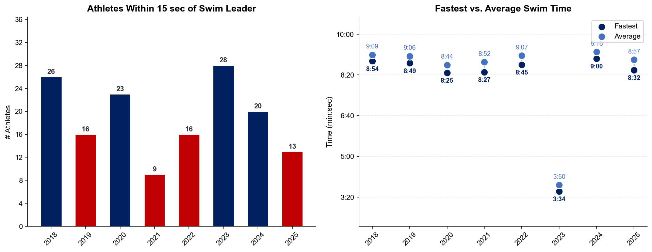
Swim Exit Dynamics — Elite Men
Hamburg

Slide 18
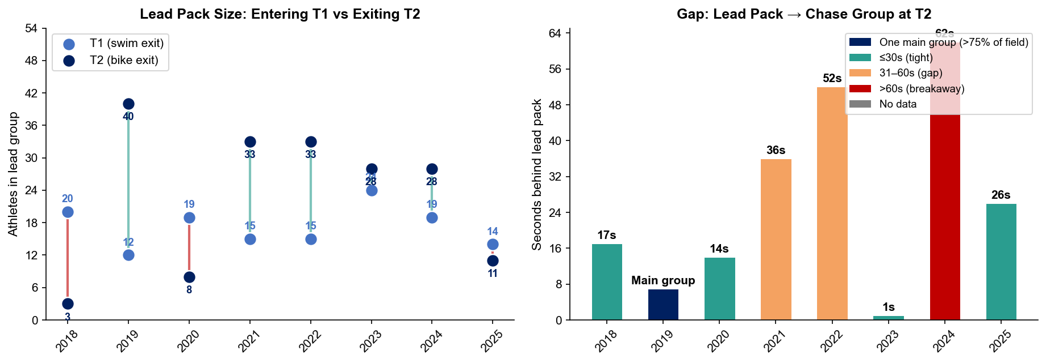
Bike Pack Evolution — Elite Men
Hamburg
Lead pack = athletes within 15 sec of leader. T1 = lead group entering the bike; T2 = lead group exiting the bike.
Year | Lead Size @ T1 | Lead Size @ T2 | Change | Chase Group @ T2 | Chase Gap*
2018 | 20 | 3 | -17 | 37 | 17s
2019 | 12 | 40 | +28 | 2 | 28s
2020 | 19 | 8 | -11 | 34 | 14s
2021 | 15 | 33 | +18 | 9 | 36s
2022 | 15 | 33 | +18 | 13 | 52s
2023 | 24 | 28 | +4 | 23 | 1s
2024 | 19 | 28 | +9 | 16 | 62s
2025 | 14 | 11 | -3 | 20 | 26s
Lead pack = athletes within 15 sec of leader. Chase group = athletes within 15 sec of the first athlete outside the lead pack. * Chase Gap = seconds from the last lead-pack athlete to the first chase-group athlete at T2.
Dropouts: 2018: 8 DNF/LAP (1 in lead group at t1) | 2019: 8 DNF/LAP | 2020: 6 DNF/LAP (1 in lead group at t1) | 2021: 2 DNF/LAP | 2022: 1 DNF/LAP | 2024: 5 DNF/LAP (1 in lead group at t1) | 2025: 6 DNF/LAP (1 in lead group at t1)

Slide 19
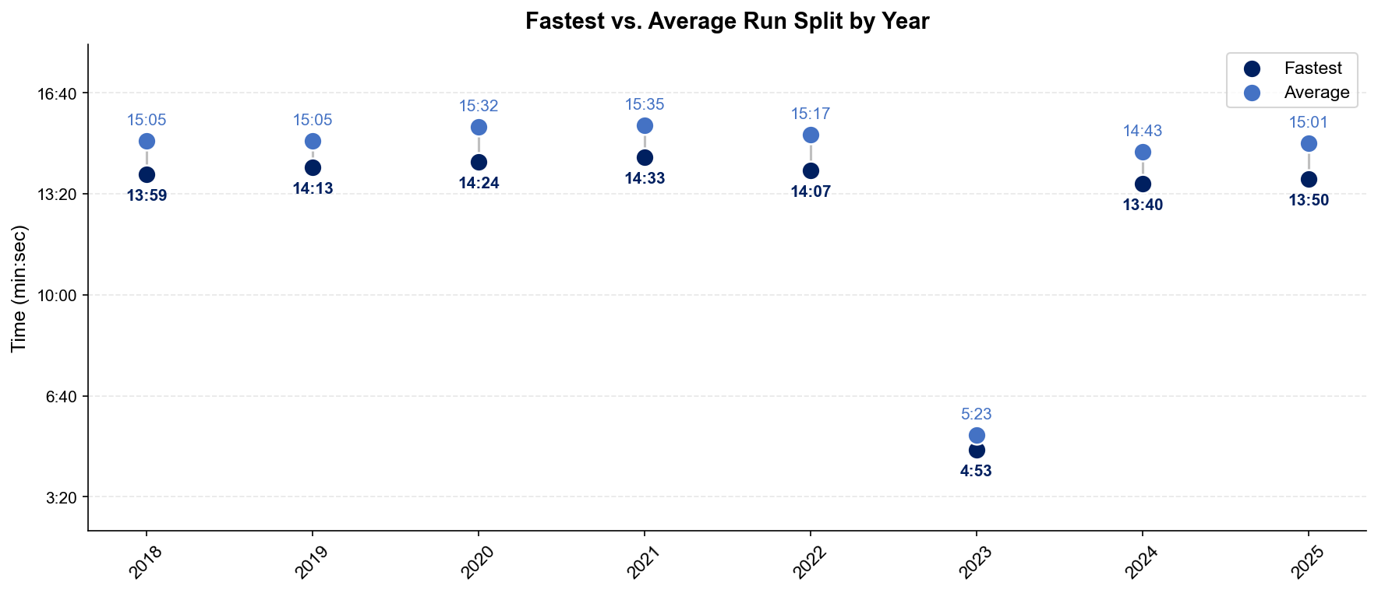
Run Split Analysis — Elite Men
Hamburg

Slide 20
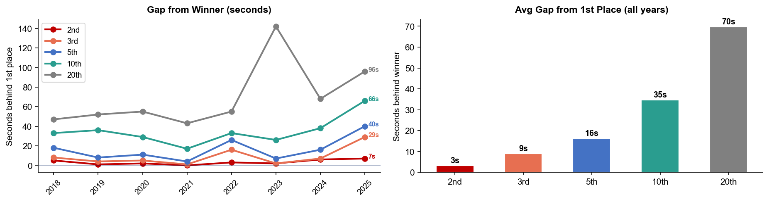
Key Position Times — Elite Men
Hamburg
Year | 1st | 2nd | 3rd | 5th | 10th | 20th
2018 | 53:24 | 53:29 +5s | 53:32 +8s | 53:42 +18s | 53:57 +33s | 54:11 +47s
2019 | 55:09 | 55:10 +1s | 55:13 +4s | 55:17 +8s | 55:45 +36s | 56:01 +52s
2020 | 49:13 | 49:15 +2s | 49:18 +5s | 49:24 +11s | 49:42 +29s | 50:08 +55s
2021 | 53:08 | 53:08 | 53:09 +1s | 53:12 +4s | 53:25 +17s | 53:51 +43s
2022 | 53:10 | 53:13 +3s | 53:26 +16s | 53:36 +26s | 53:43 +33s | 54:05 +55s
2023 | 19:26 | 19:28 +2s | 19:28 +2s | 19:33 +7s | 19:52 +26s | 21:48 +142s
2024 | 50:03 | 50:09 +6s | 50:10 +7s | 50:19 +16s | 50:41 +38s | 51:11 +68s
2025 | 50:07 | 50:14 +7s | 50:36 +29s | 50:47 +40s | 51:13 +66s | 51:43 +96s

Slide 21
Race Conditions — Elite Men
Hamburg
Year | Date | Air Temp | Humidity | Wind (km/h) | Precip (mm) | Water Temp | Wetsuit | Conditions
2018 | Jul 14 | 21 | 67% | 11 | 0.0 | 20.9 | forbidden | —
2019 | Jul 06 | 15.0°* | 87% | 16 | 1.1 | — | — | —
2020 | Sep 05 | 13.8°* | 94% | 14 | — | — | — | —
2021 | Sep 18 | 15.5°* | 84% | 10 | 0.0 | — | — | —
2022 | Jul 09 | 23.4 | 81% | — | 0.1 | 20.8 | forbidden | —
2023 | Jul 15 | 24.4°* | 54% | — | 0.0 | — | forbidden | —
2024 | Jul 13 | 18.9 | 79% | 22 | 0.0 | 21.3 | forbidden | —
2025 | Jul 12 | 23.6 | 76% | 14 | 0.2 | 21.1 | forbidden | —
Air temp, humidity, wind, and precipitation sourced from Open-Meteo historical archive (race window 08:00–11:00 local) where WT API data is absent. Values marked * are Open-Meteo estimates. Water temp and wetsuit ruling are from the World Triathlon API per program.

Slide 22
ELITE WOMEN

Slide 23
Race Overview — Elite Women
Hamburg
RACE HISTORY AT HAMBURG
3 KEYS TO SUCCESS
The Elite Women race at Hamburg has been held 8 times in this analysis window (2018–2025). Cassandre Beaugrand is the most successful athlete in this span with 3 victories. However, last year Leonie Periault took the win after nearly the entire group came together on the bike.
1
Disregarding the shortened 2023 course, the swim here has typically significantly shortened the field. 2025 had a very small breakaway of 4 athletes emerge, and ‘21 and ’22 both had only 15 athletes within the 15 second benchmark. Expect for strong swimmer to push the pace with the non wetsuit conditions.
Historically, the women’s race has seen a bike group be able to put a gap on the chasers. While typically this lead group isn’t a small pack of less than 10, it also usually remains less than 30 riders. That changed last year though when the front pack ballooned to 45. The dynamic will depend on if the lead remains small enough to cooperate and hold speed through the turns.
2
3
Run time have continued to progress on the Hamburg course. With the leaders running 15:20 and 15:28 respectively over the past two years. Gap last year to the podium were also quite tight with 2nd and 3rd only 4 and 7 seconds back from the winner.

Slide 24
Results Summary — Elite Women
Hamburg
Year | Date | Category | Field | DNF/LAP/DNS | Winner | Winner Time | Air Temp | Water Temp | Swim km | Bike km | Run km
2018 | Jul 14 | World Championship Series | 56 | 8 | Beaugrand | 58:06 | 20.9 | 21.3 | 0.75 | 21.0 | 5.0
2019 | Jul 06 | World Championship Series * | 53 | 6 | Stanford | 59:24 | 15.0°* | — | — | — | —
2020 | Sep 05 | World Championships, World Championship Series | 65 | 5 | Taylor-Brown | 54:16 | 13.8°* | — | — | — | —
2021 | Sep 18 | World Championship Series | 46 | — | Lindemann | 58:17 | 15.5°* | — | — | — | —
2022 | Jul 09 | World Championship Series * | 56 | 3 | Duffy | 58:37 | 22.5 | 20.4 | 0.75 | 21.0 | 5.0
2023 | Jul 15 | World Championships, World Championship Series, Age-Group Event * | 57 | 1 | Beaugrand | 21:35 | 24.4°* | — | 0.30 | 7.5 | 1.75
2024 | Jul 13 | World Championship Series * | 55 | 4 | Beaugrand | 55:19 | 19.2 | 21.2 | 0.75 | 19.8 | 4.9
2025 | Jul 12 | World Championship Series * | 55 | 3 | Periault | 56:25 | 21.3 | 21. | 0.75 | 19.8 | 5.0
* Course distance changed vs. prior year

Slide 25
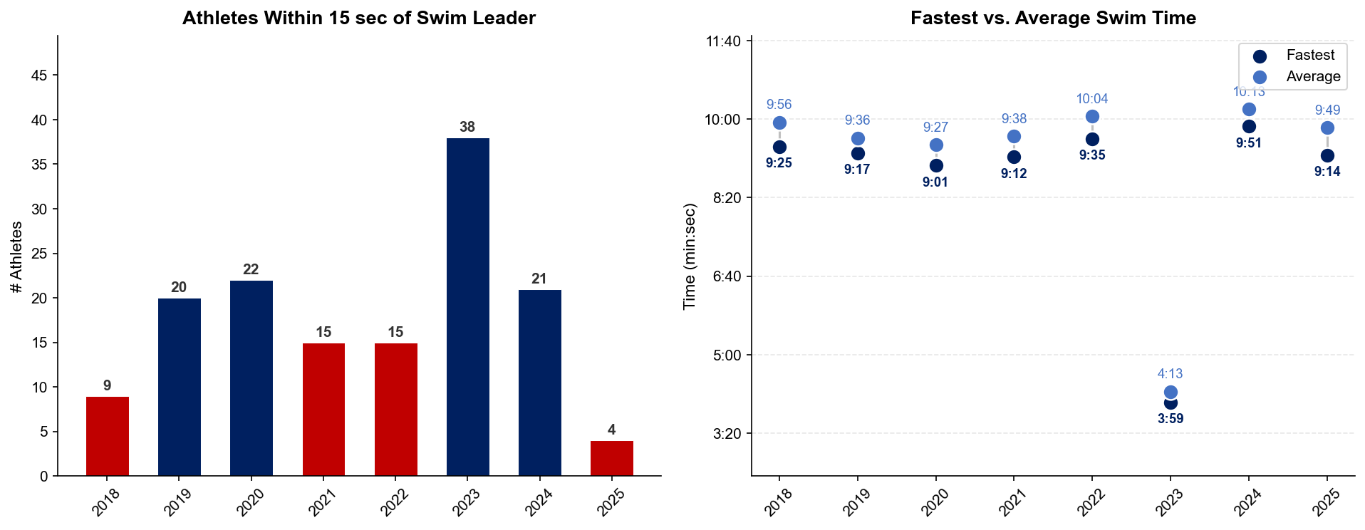
Swim Exit Dynamics — Elite Women
Hamburg

Slide 26
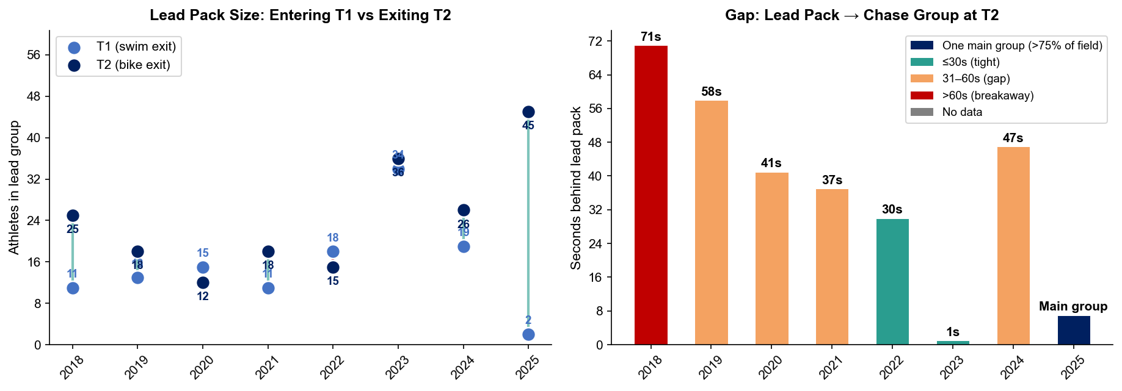
Bike Pack Evolution — Elite Women
Hamburg
Lead pack = athletes within 15 sec of leader. T1 = lead group entering the bike; T2 = lead group exiting the bike.
Year | Lead Size @ T1 | Lead Size @ T2 | Change | Chase Group @ T2 | Chase Gap*
2018 | 11 | 25 | +14 | 12 | 71s
2019 | 13 | 18 | +5 | 7 | 58s
2020 | 15 | 12 | -3 | 5 | 41s
2021 | 11 | 18 | +7 | 13 | 37s
2022 | 18 | 15 | -3 | 27 | 30s
2023 | 34 | 36 | +2 | 11 | 1s
2024 | 19 | 26 | +7 | 10 | 47s
2025 | 2 | 45 | +43 | 7 | 82s
Lead pack = athletes within 15 sec of leader. Chase group = athletes within 15 sec of the first athlete outside the lead pack. * Chase Gap = seconds from the last lead-pack athlete to the first chase-group athlete at T2.
Dropouts: 2018: 6 DNF/LAP | 2019: 5 DNF/LAP | 2020: 5 DNF/LAP | 2022: 2 DNF/LAP (1 in lead group at t1) | 2024: 3 DNF/LAP (1 in lead group at t1) | 2025: 3 DNF/LAP

Slide 27
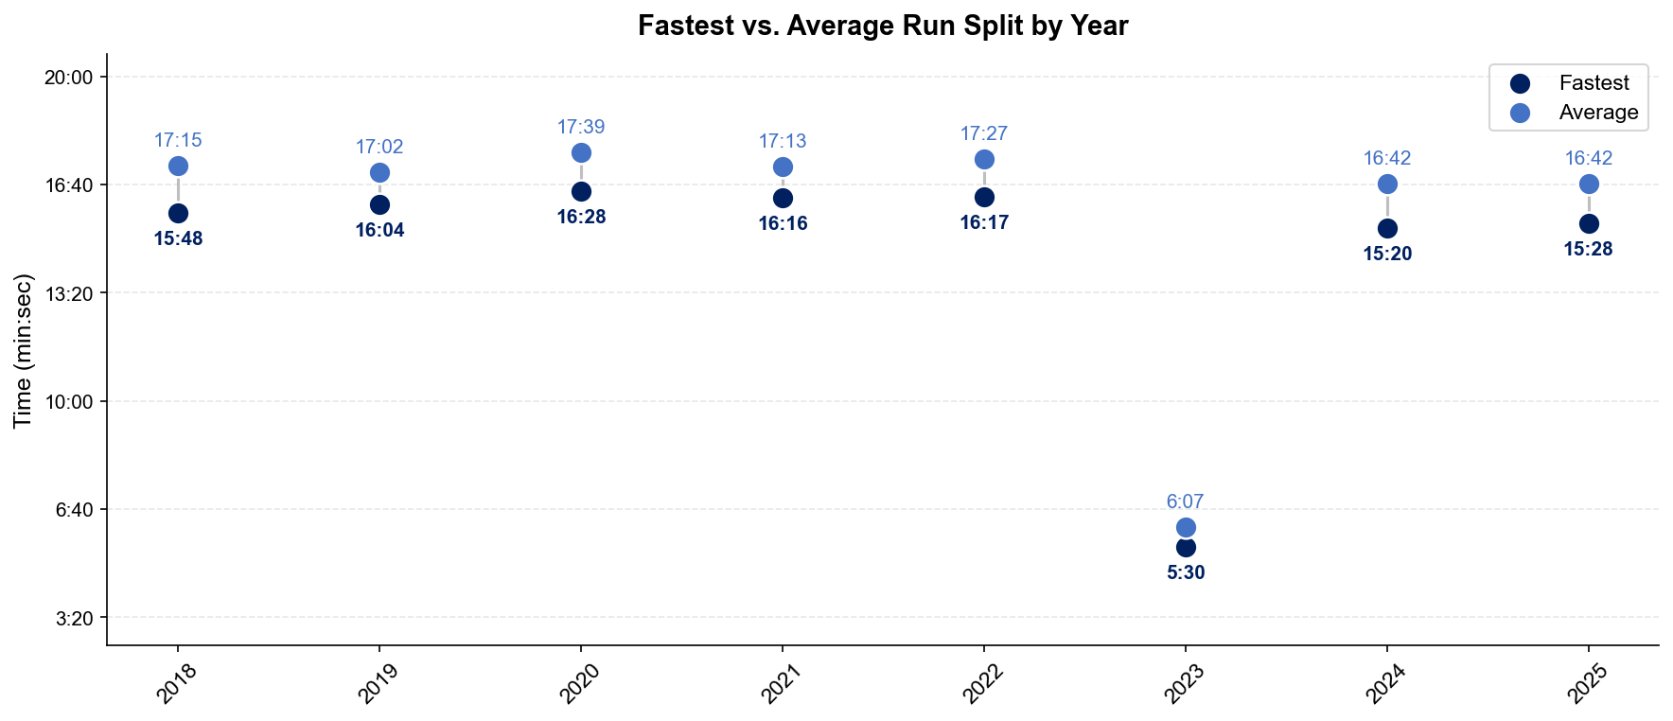
Run Split Analysis — Elite Women
Hamburg

Slide 28
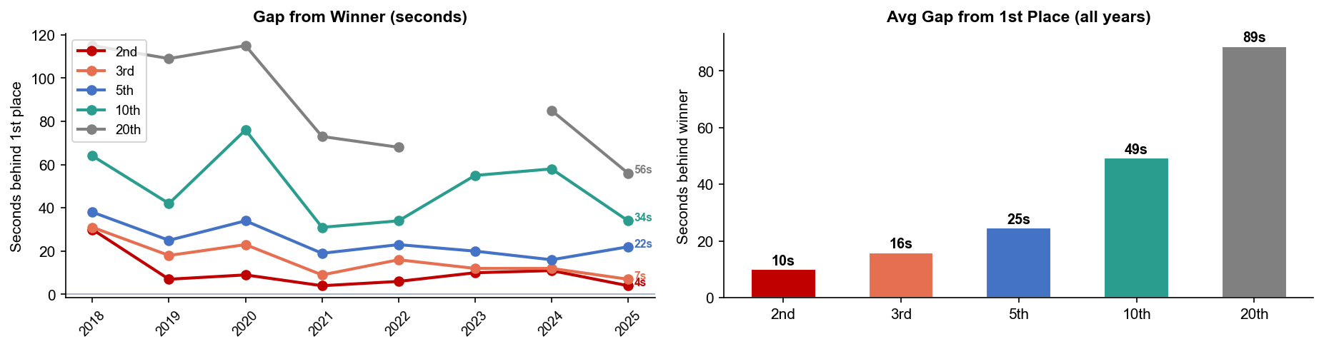
Key Position Times — Elite Women
Hamburg
Year | 1st | 2nd | 3rd | 5th | 10th | 20th
2018 | 58:06 | 58:36 +30s | 58:37 +31s | 58:44 +38s | 59:10 +64s | 1:00:01 +115s
2019 | 59:24 | 59:31 +7s | 59:42 +18s | 59:49 +25s | 1:00:06 +42s | 1:01:13 +109s
2020 | 54:16 | 54:25 +9s | 54:39 +23s | 54:50 +34s | 55:32 +76s | 56:11 +115s
2021 | 58:17 | 58:21 +4s | 58:26 +9s | 58:36 +19s | 58:48 +31s | 59:30 +73s
2022 | 58:37 | 58:43 +6s | 58:53 +16s | 59:00 +23s | 59:11 +34s | 59:45 +68s
2023 | 21:35 | 21:45 +10s | 21:47 +12s | 21:55 +20s | 22:30 +55s | —
2024 | 55:19 | 55:30 +11s | 55:31 +12s | 55:35 +16s | 56:17 +58s | 56:44 +85s
2025 | 56:25 | 56:29 +4s | 56:32 +7s | 56:47 +22s | 56:59 +34s | 57:21 +56s

Slide 29
Race Conditions — Elite Women
Hamburg
Year | Date | Air Temp | Humidity | Wind (km/h) | Precip (mm) | Water Temp | Wetsuit | Conditions
2018 | Jul 14 | 20.9 | 67% | 11 | 0.0 | 21.3 | forbidden | —
2019 | Jul 06 | 15.0°* | 87% | 16 | 1.1 | — | — | —
2020 | Sep 05 | 13.8°* | 94% | 14 | — | — | — | —
2021 | Sep 18 | 15.5°* | 84% | 10 | 0.0 | — | — | —
2022 | Jul 09 | 22.5 | 81% | — | 0.1 | 20.4 | forbidden | —
2023 | Jul 15 | 24.4°* | 54% | — | 0.0 | — | forbidden | —
2024 | Jul 13 | 19.2 | 79% | 22 | 0.0 | 21.2 | forbidden | —
2025 | Jul 12 | 21.3 | 76% | 14 | 0.2 | 21. | forbidden | —
Air temp, humidity, wind, and precipitation sourced from Open-Meteo historical archive (race window 08:00–11:00 local) where WT API data is absent. Values marked * are Open-Meteo estimates. Water temp and wetsuit ruling are from the World Triathlon API per program.

